Slide 1

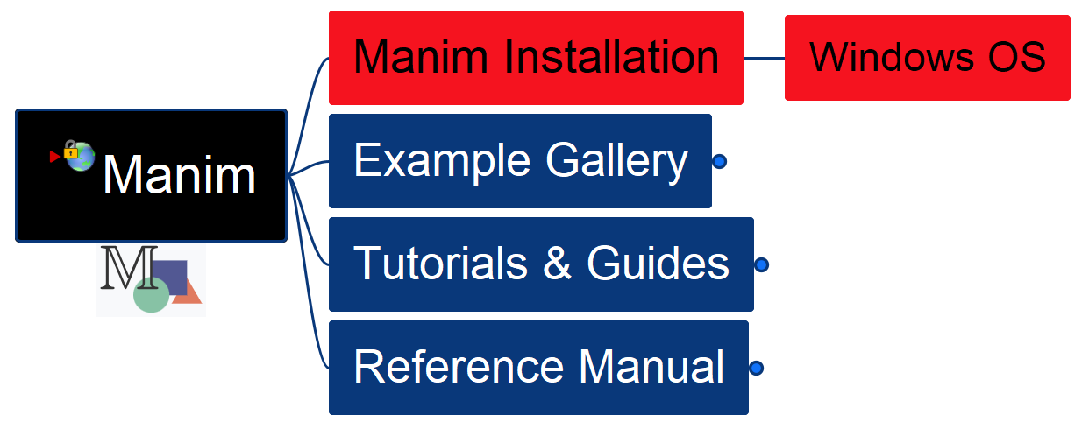

Learn Manim Library by Practice – Opening and Installation
001

Slide 2
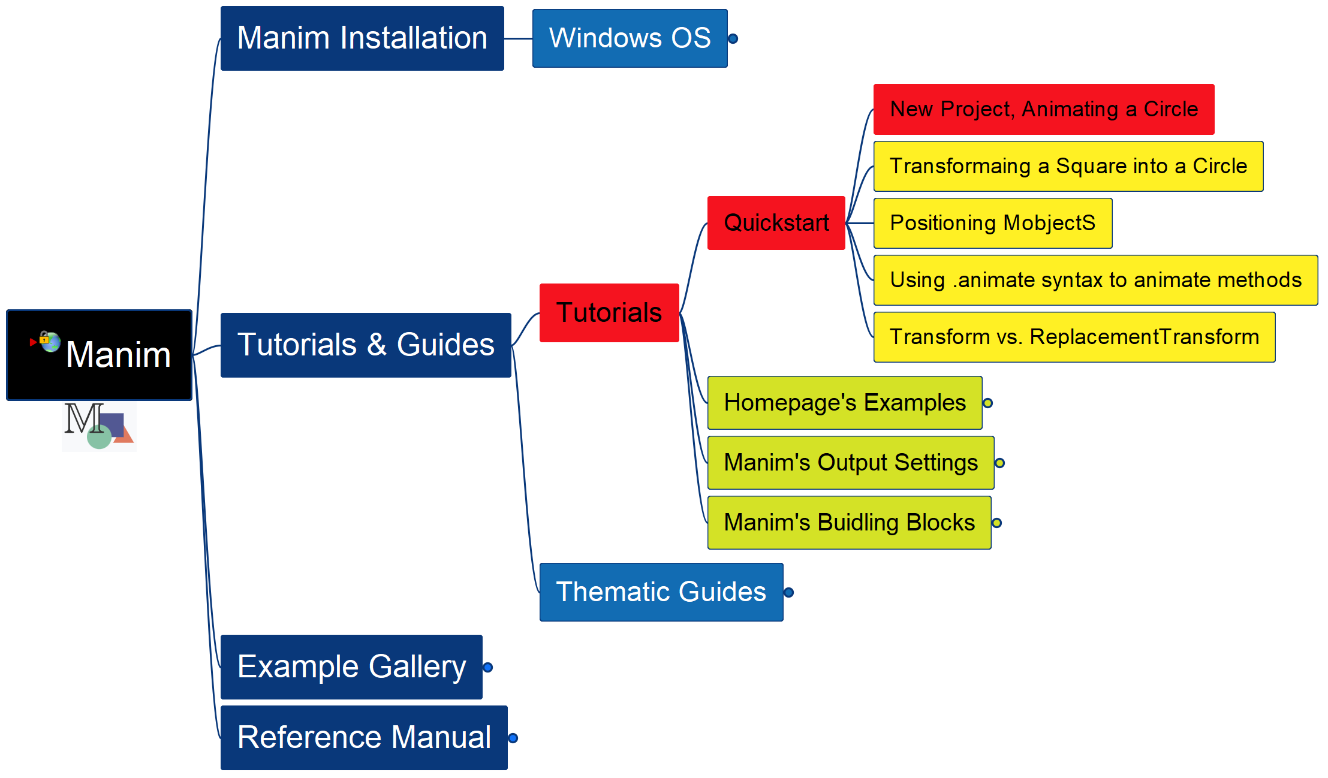
Learning Manim
002
Tutorial – QuickStart – New Project

Slide 3
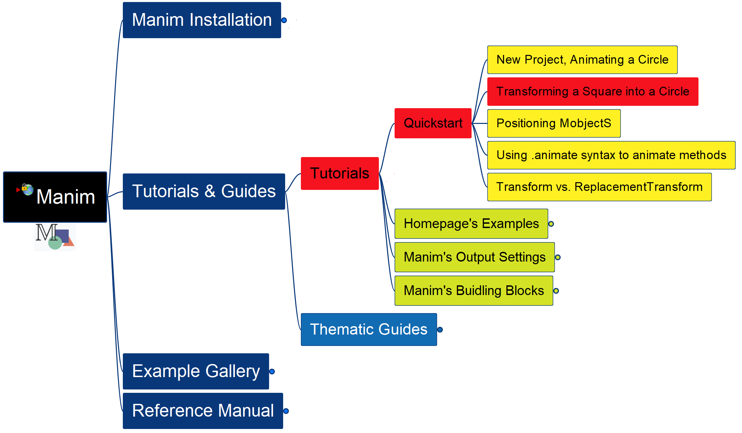
Learning Manim
003
Transform a Square into a Circle

Slide 4
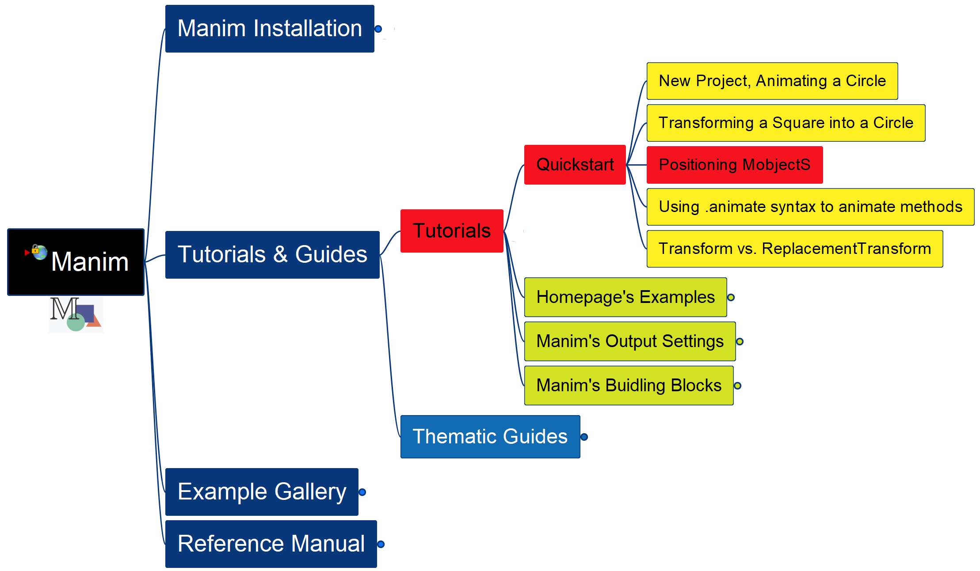
Learning Manim
004
Positioning MobjectS

Slide 5
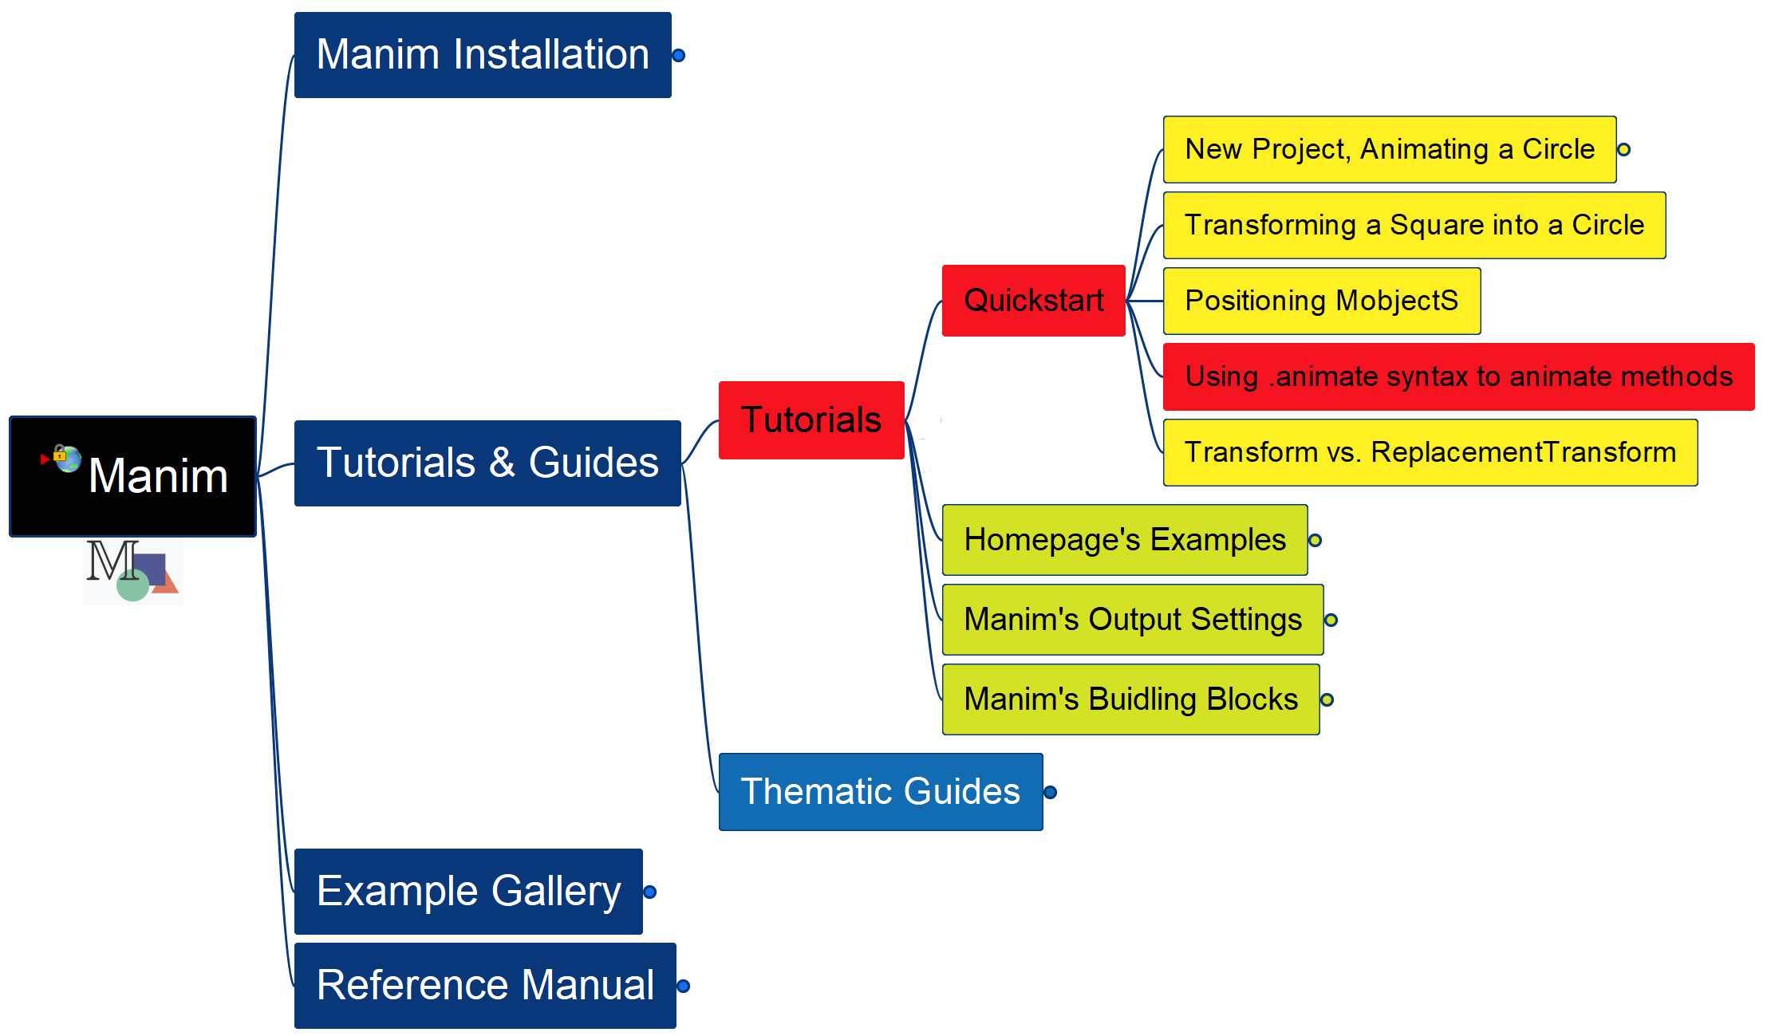
Learning Manim
005
Using .animate syntax

Slide 6
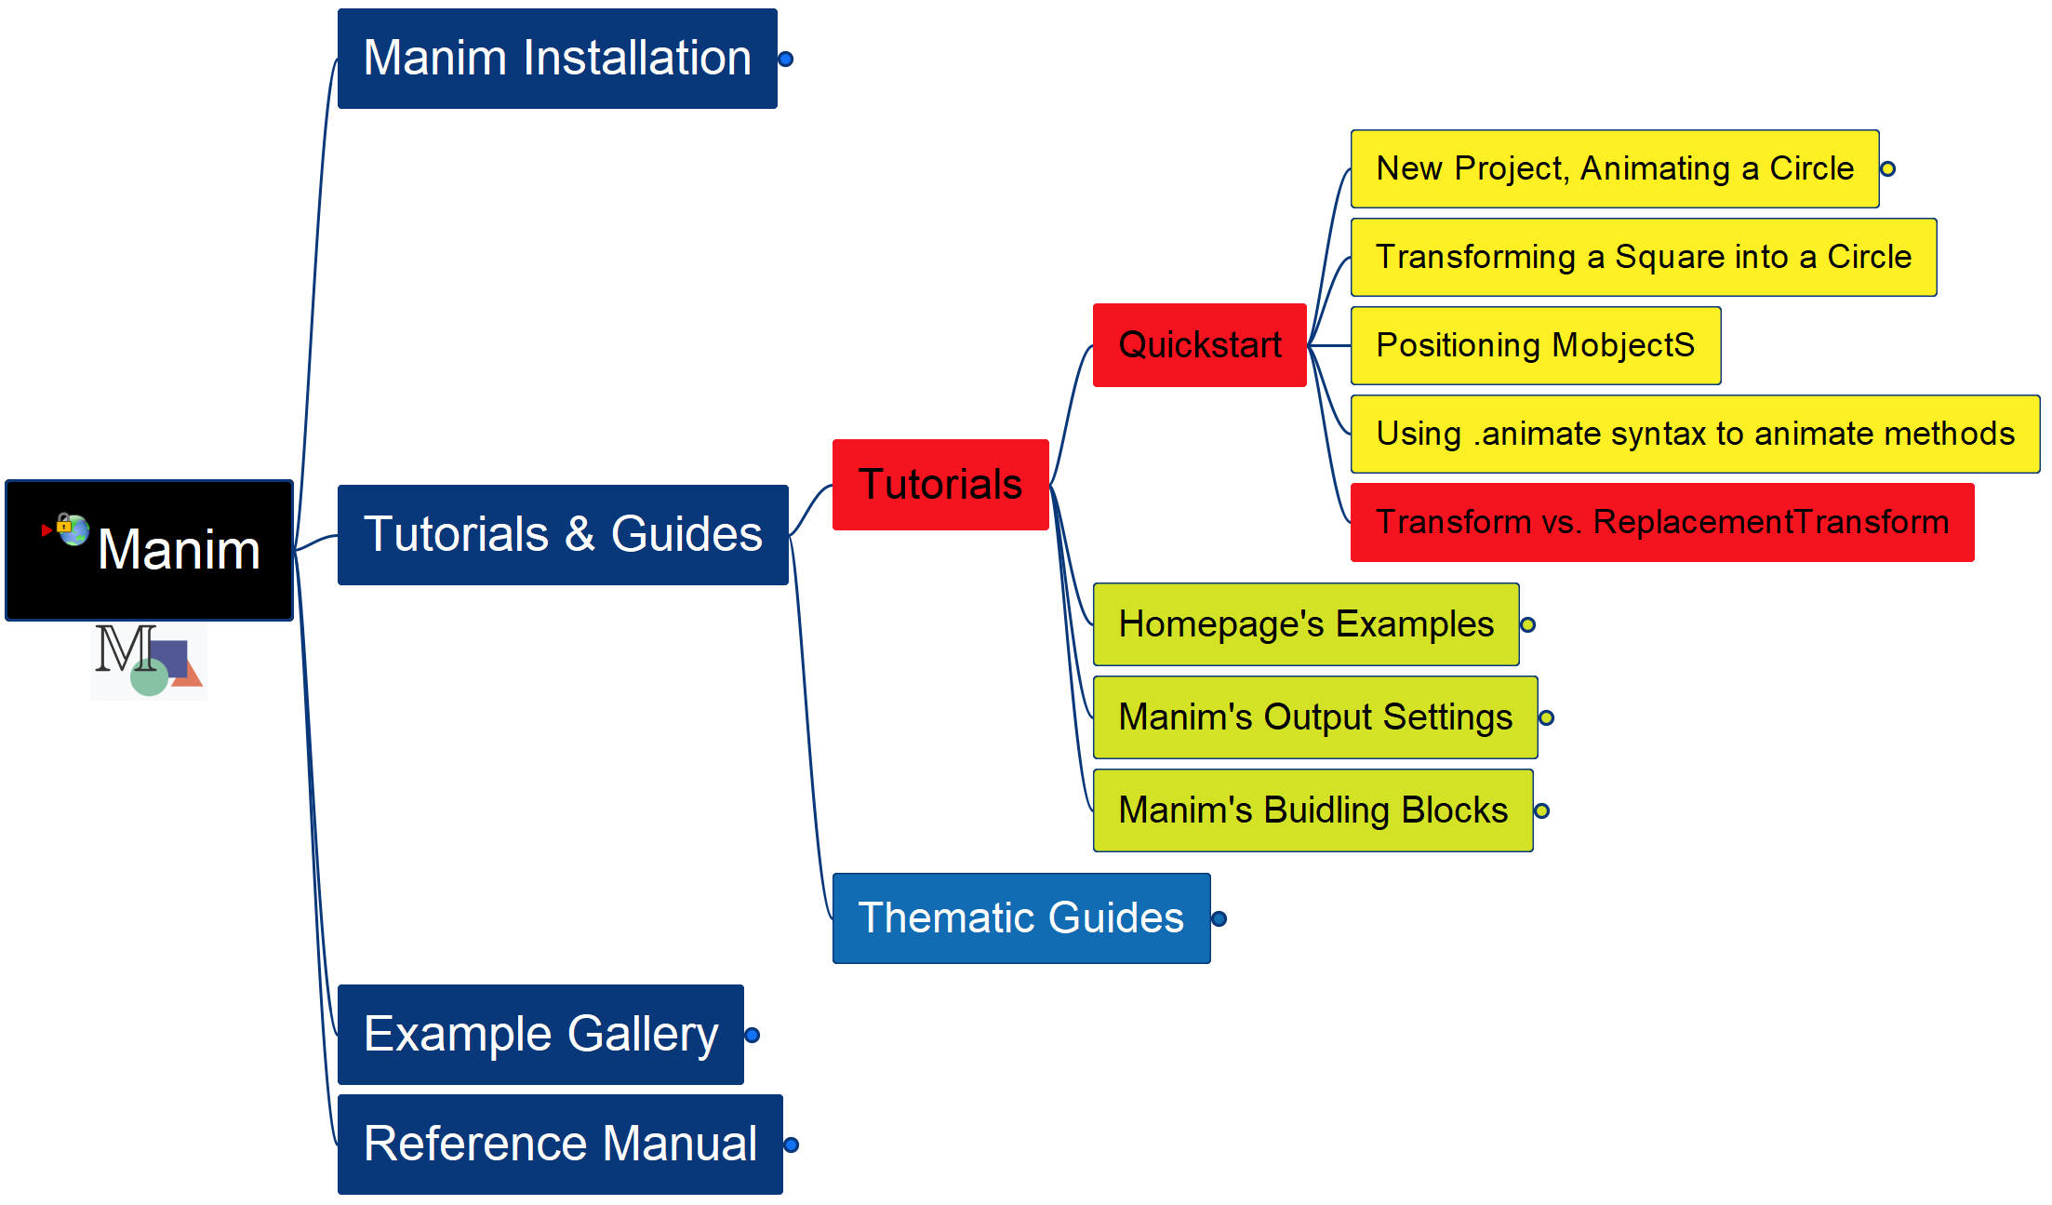
Learning Manim
006
Transform vs. ReplacementTransform

Slide 7
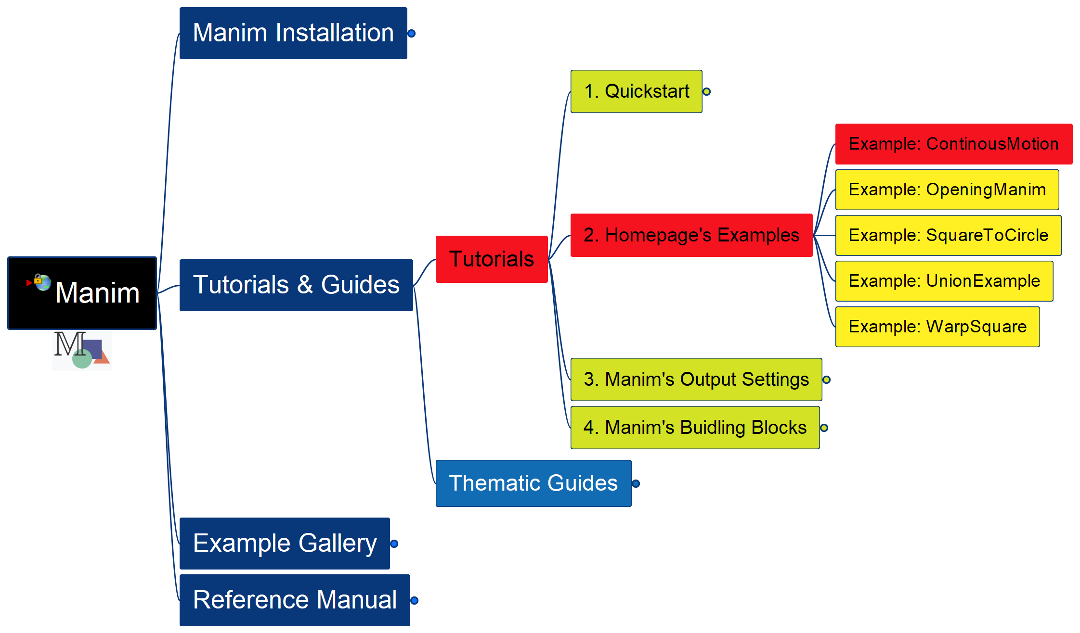
Learning Manim
007
Example: Continuous Motion

Slide 8
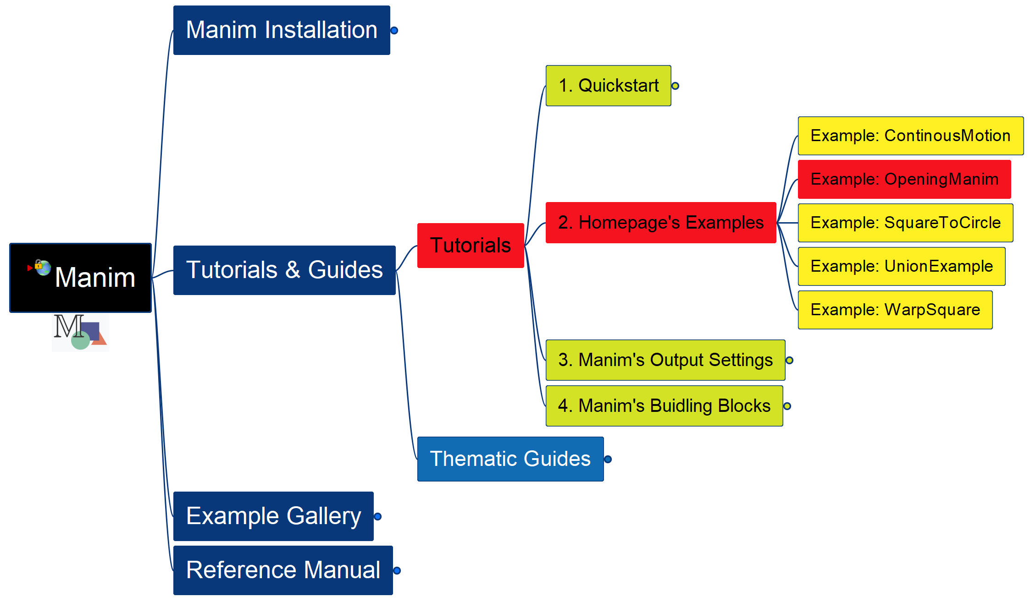
Learning Manim
Example: Opening Manim
008

Slide 9
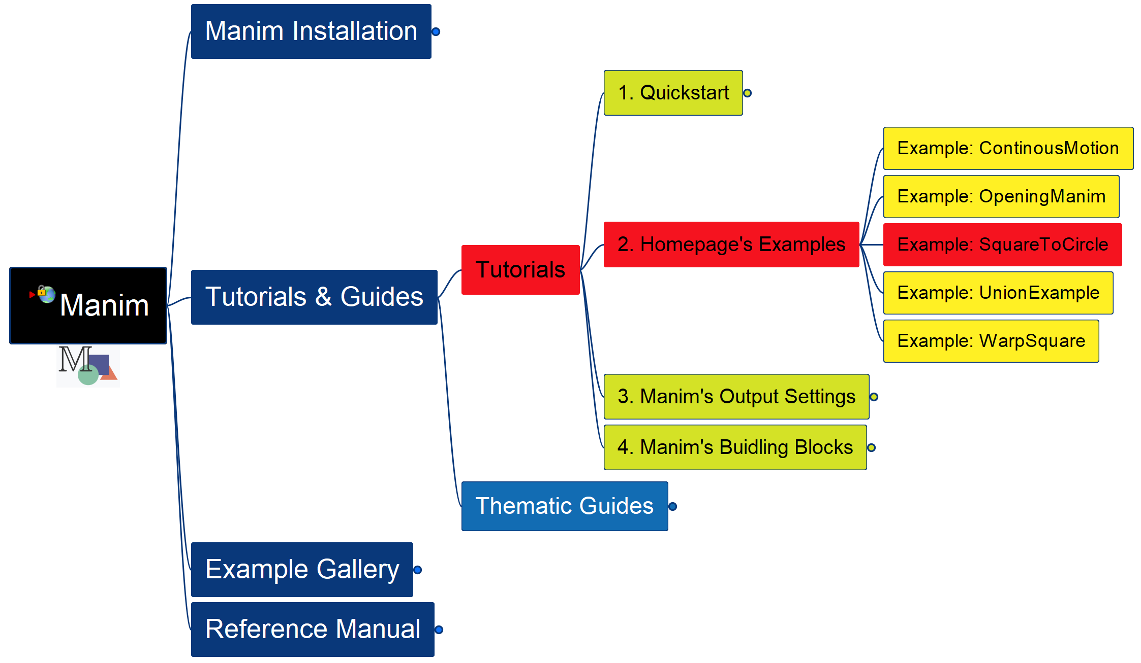
Learning Manim
Example: Square To Circle
009

Slide 10
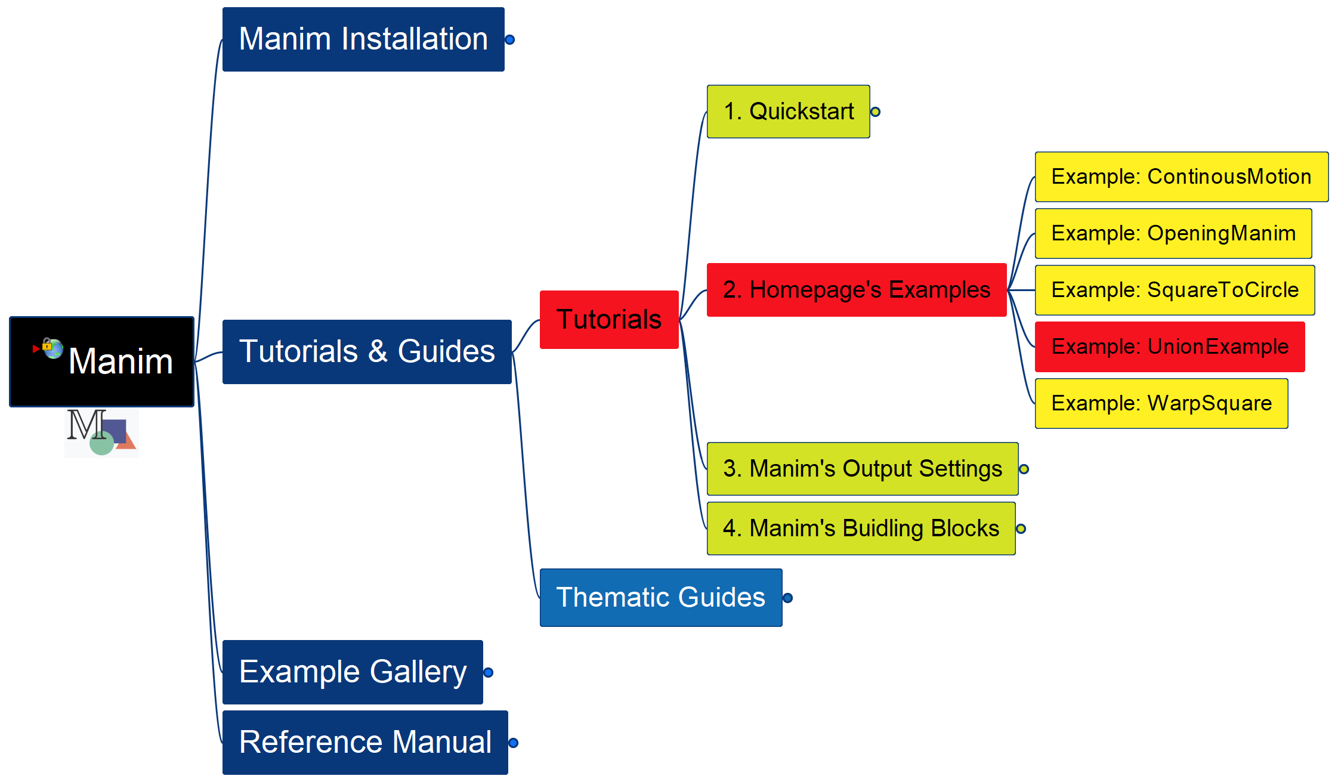
Learning Manim
Example: Union
010

Slide 11
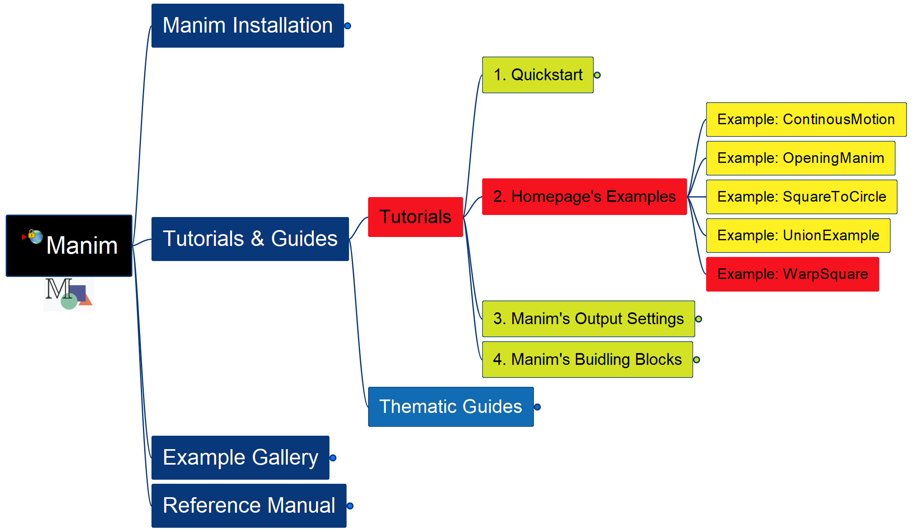
Learning Manim
Example: Warp Square
011

Slide 12
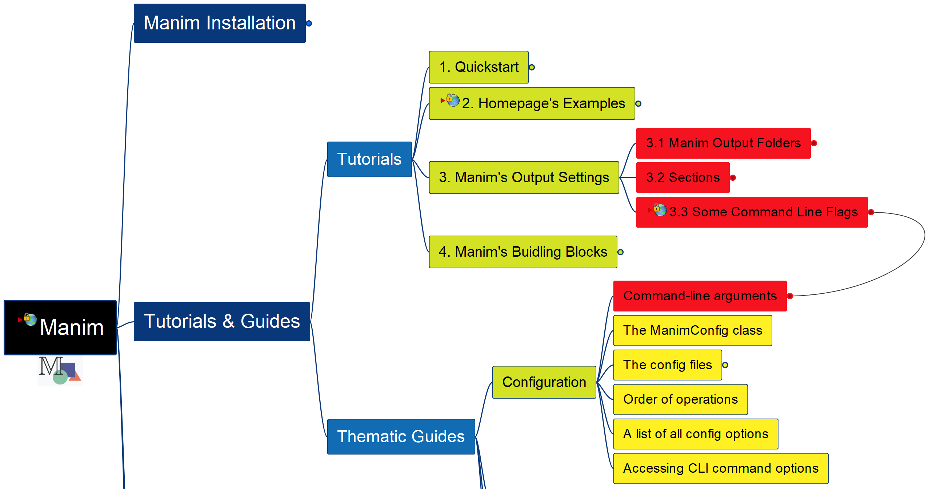
Learning Manim
Manim’s Output Settings
012

Slide 13
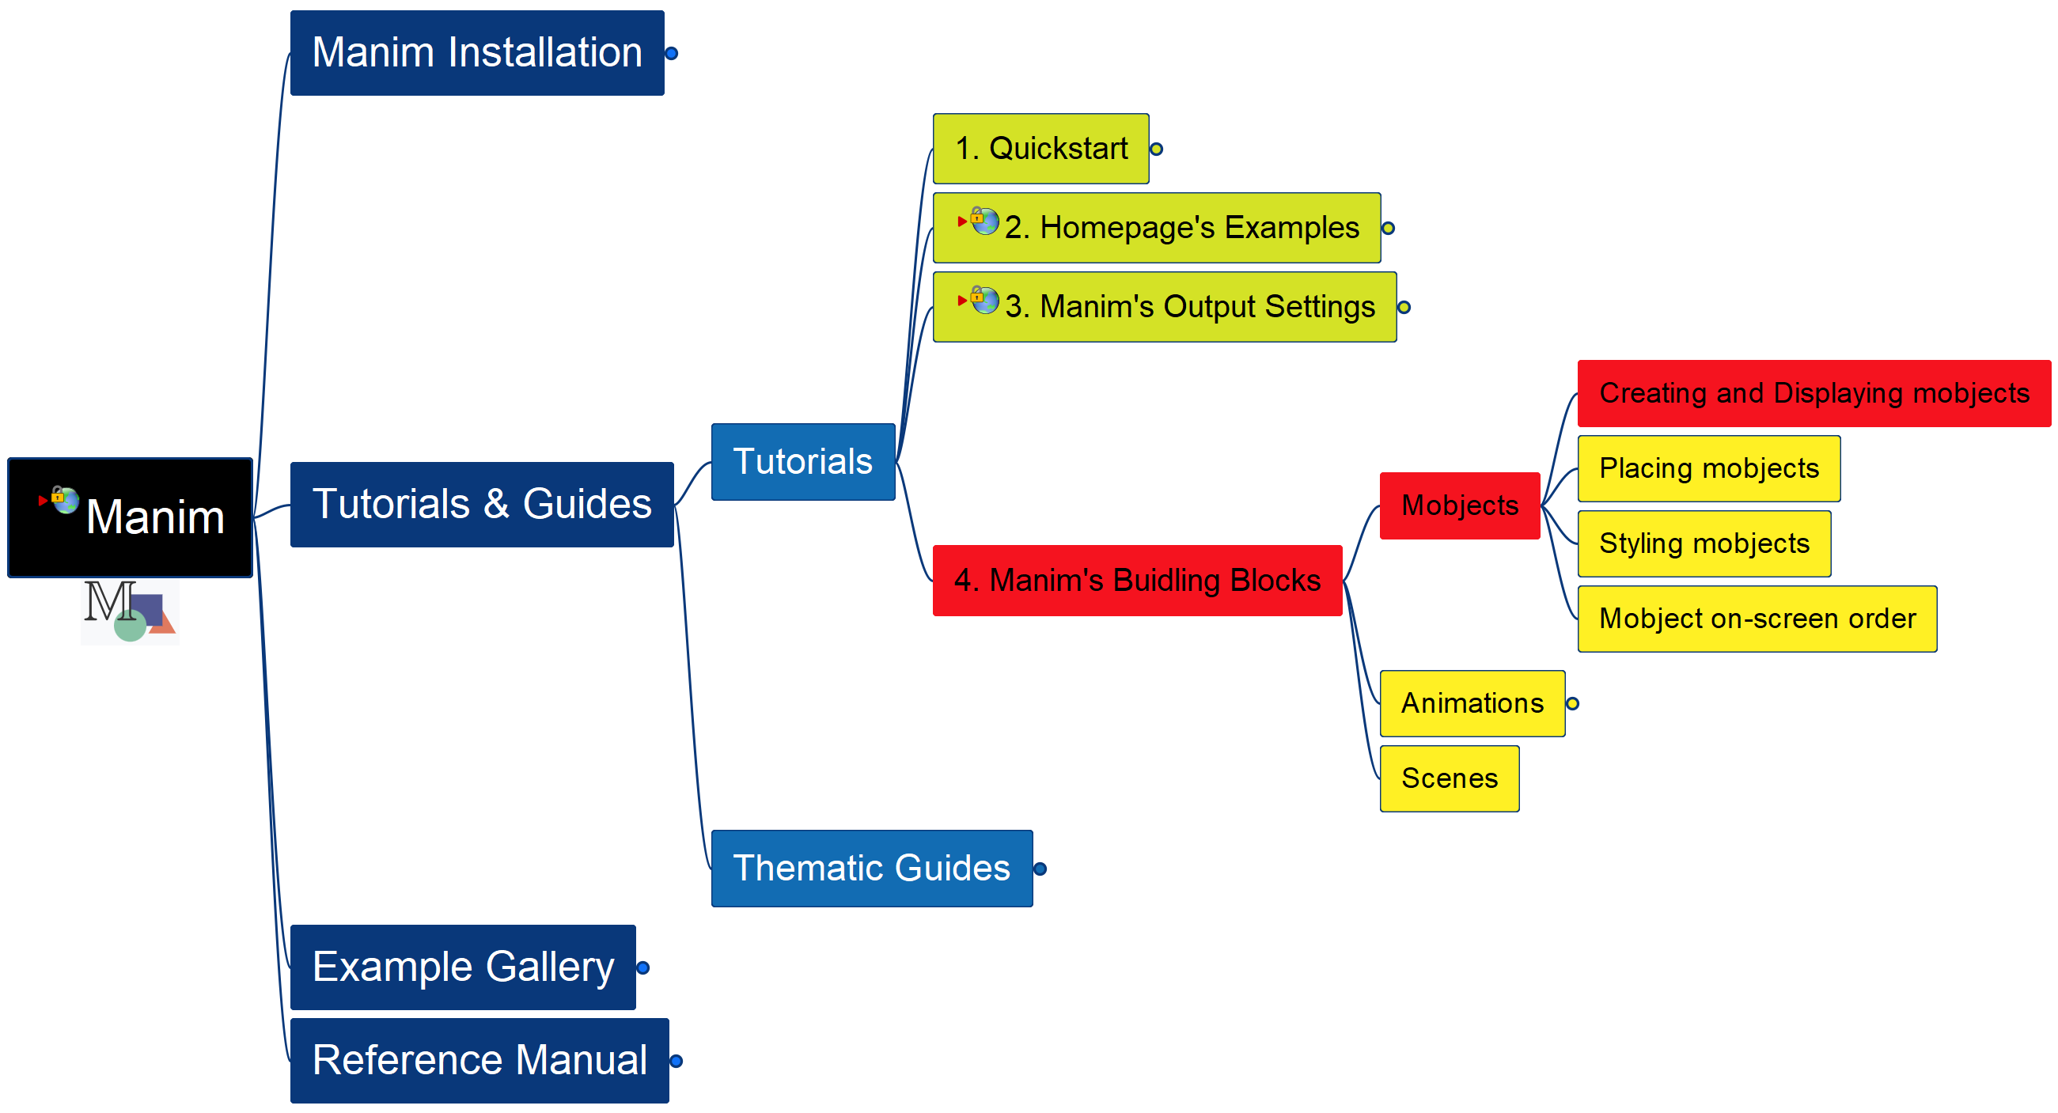
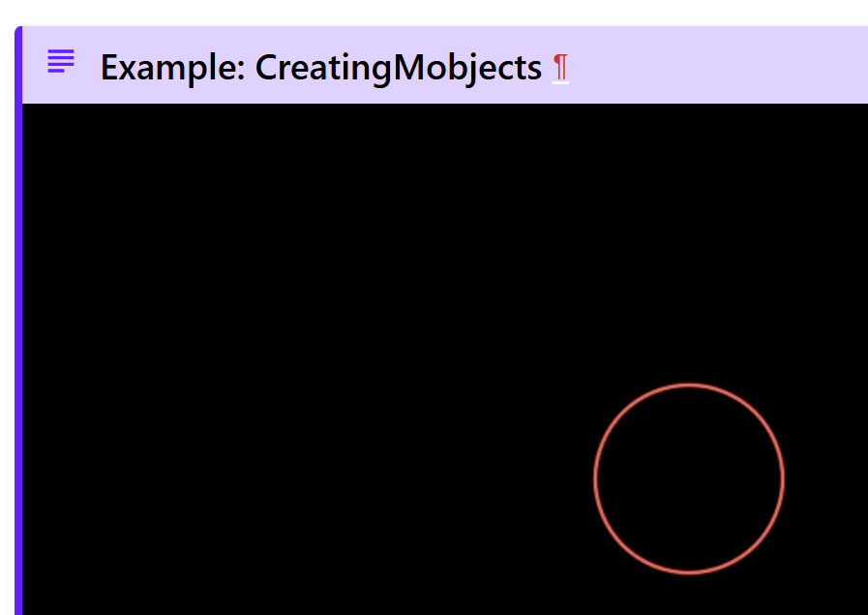
Learning Manim
Building Block – Mobjects – Create and Display
013

Slide 14
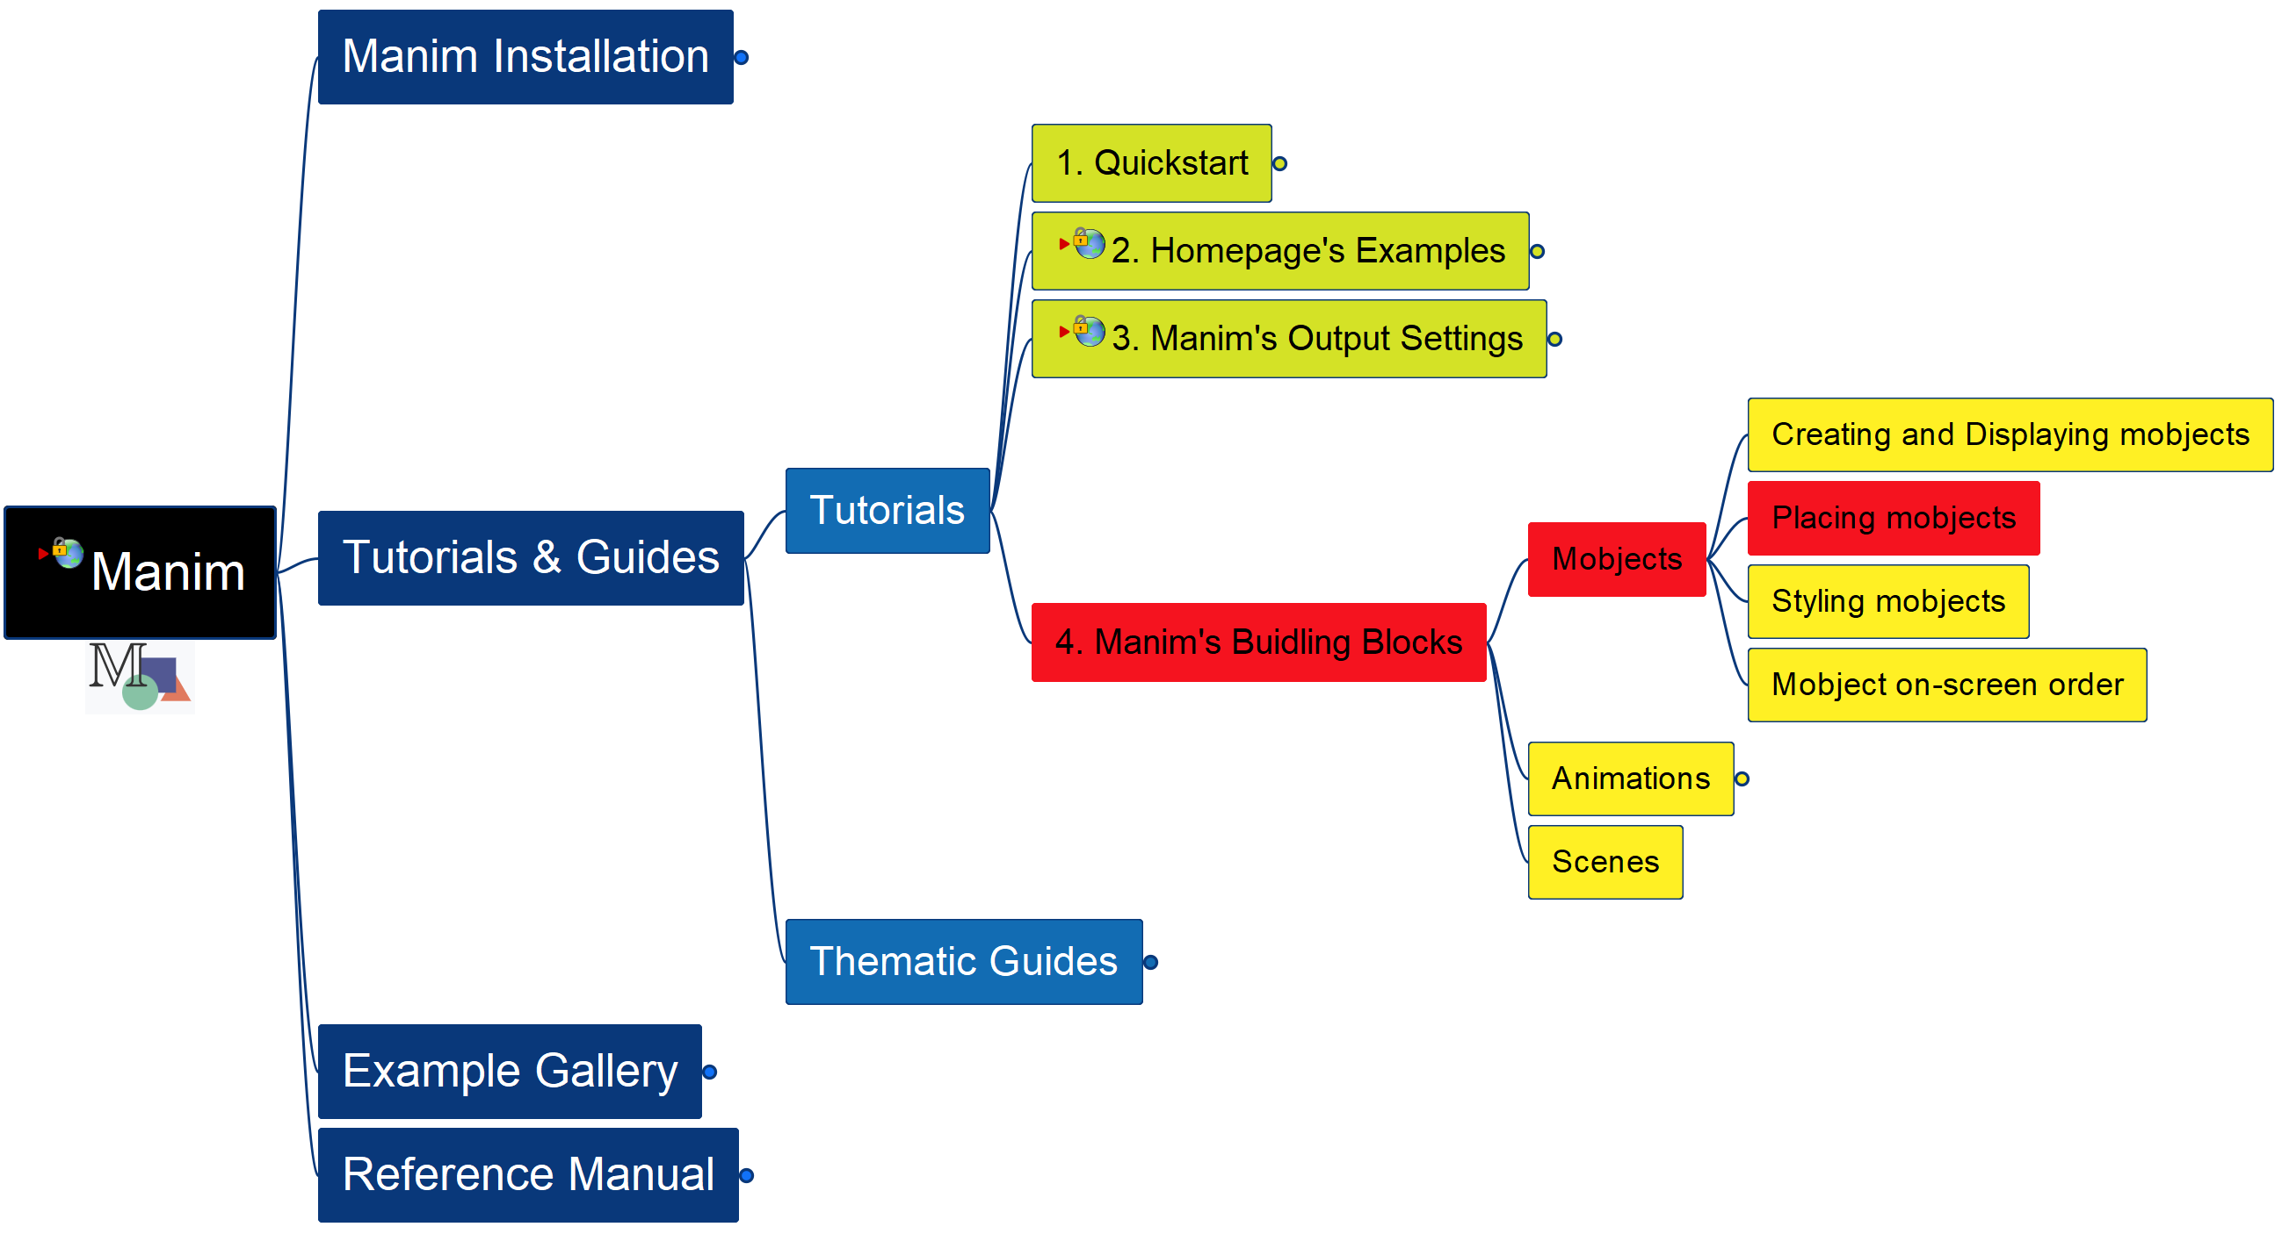

Learning Manim
Building Block – Mobjects – Placing
014

Slide 15
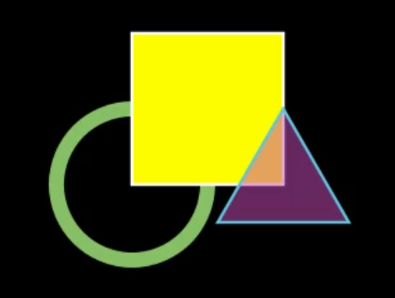
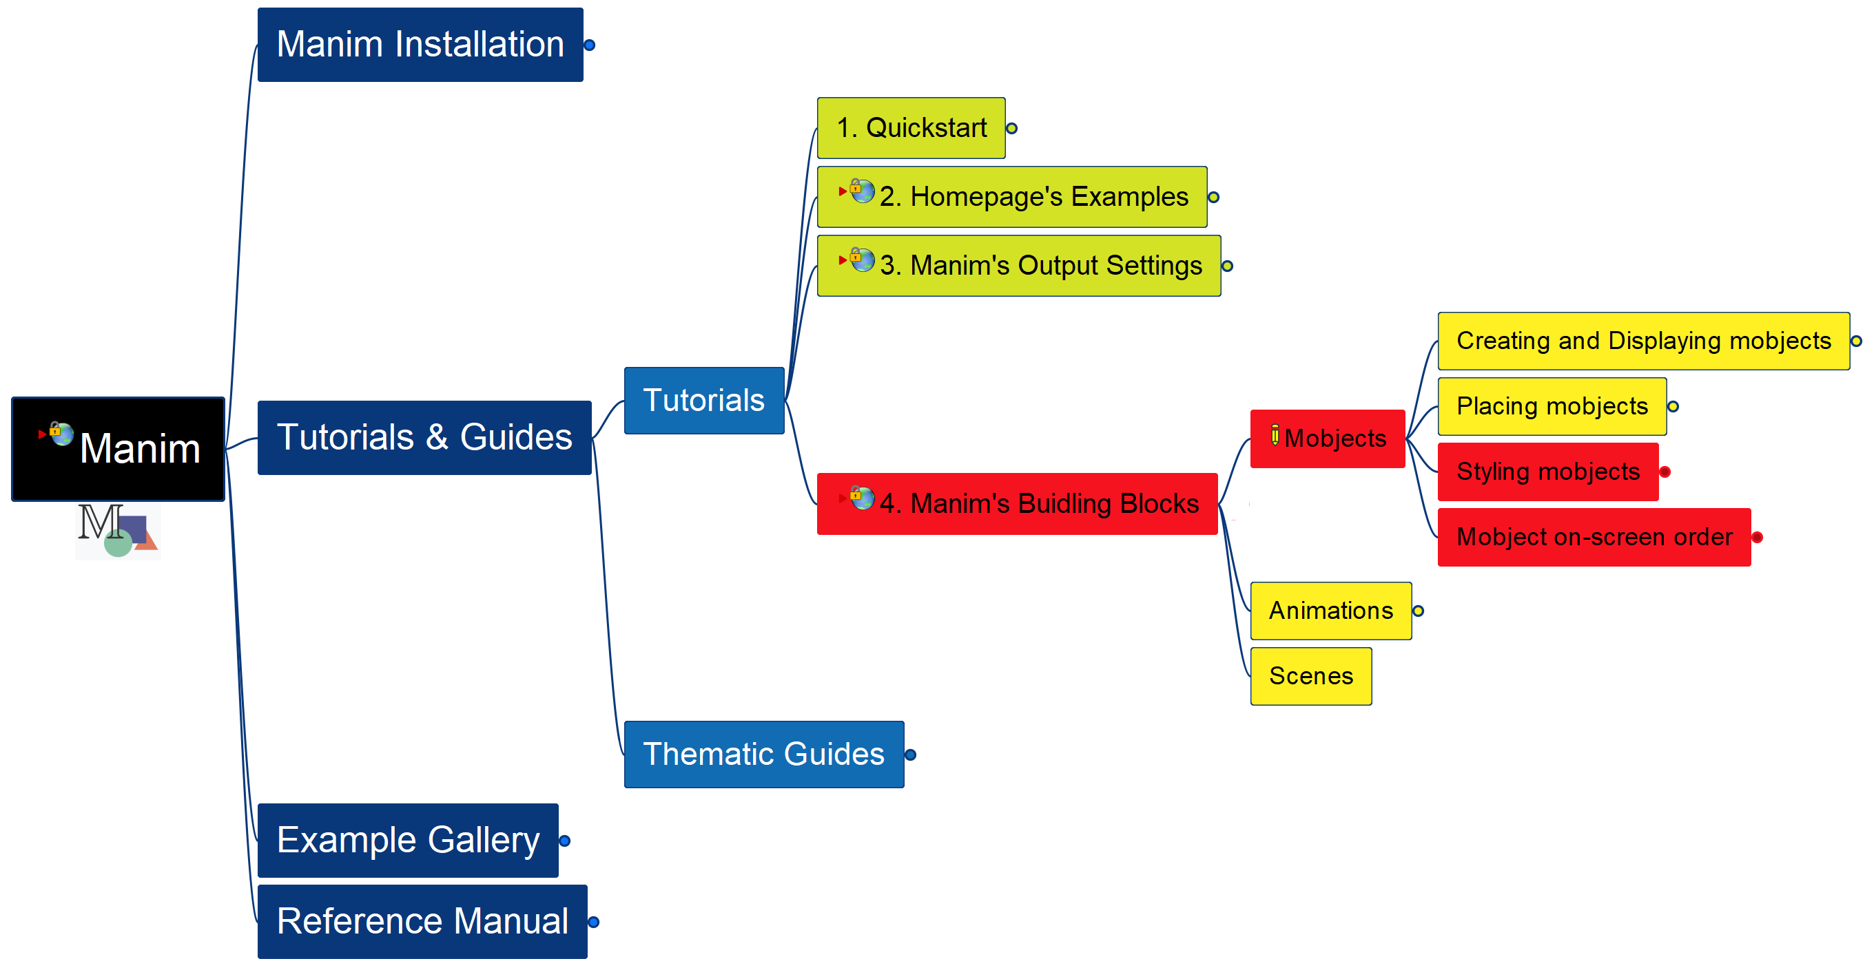
Learning Manim
Building Block – Mobjects – Styling, Ordering
015

Slide 16
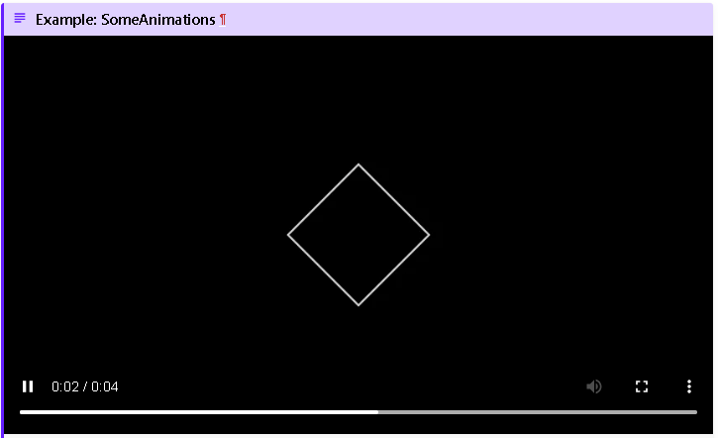
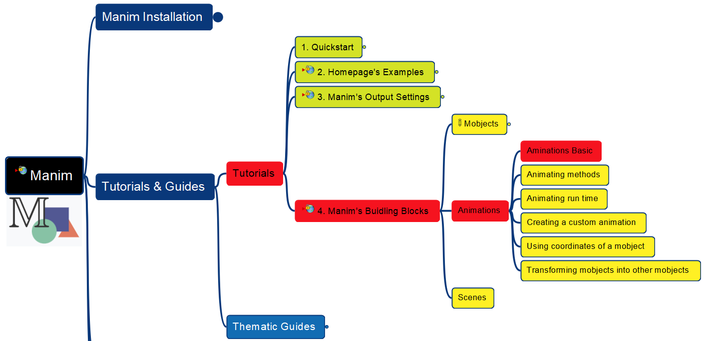
Learning Manim
Building Block – Animations - Basics
016
Reinstall Manim

Slide 17
Learning Manim
Building Block – Animations - Basics
017

Slide 18
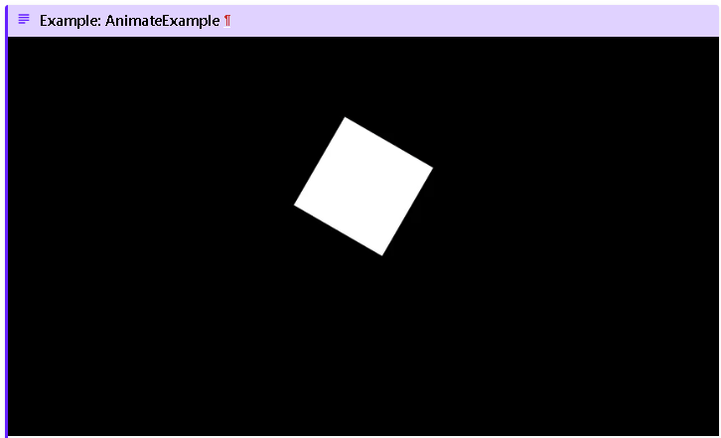
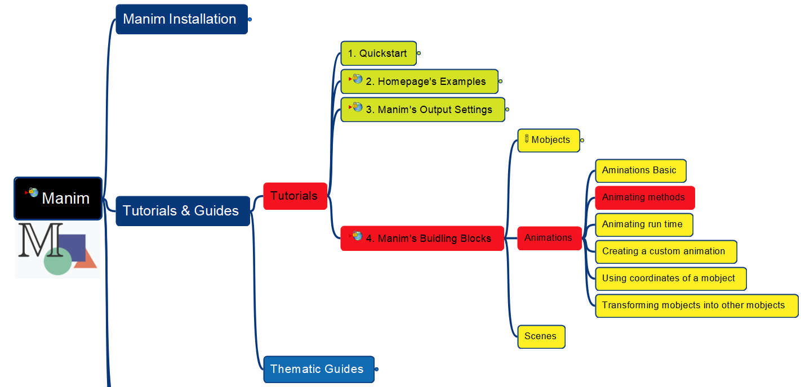
Learning Manim
Building Block – Animations - Methods
018

Slide 19
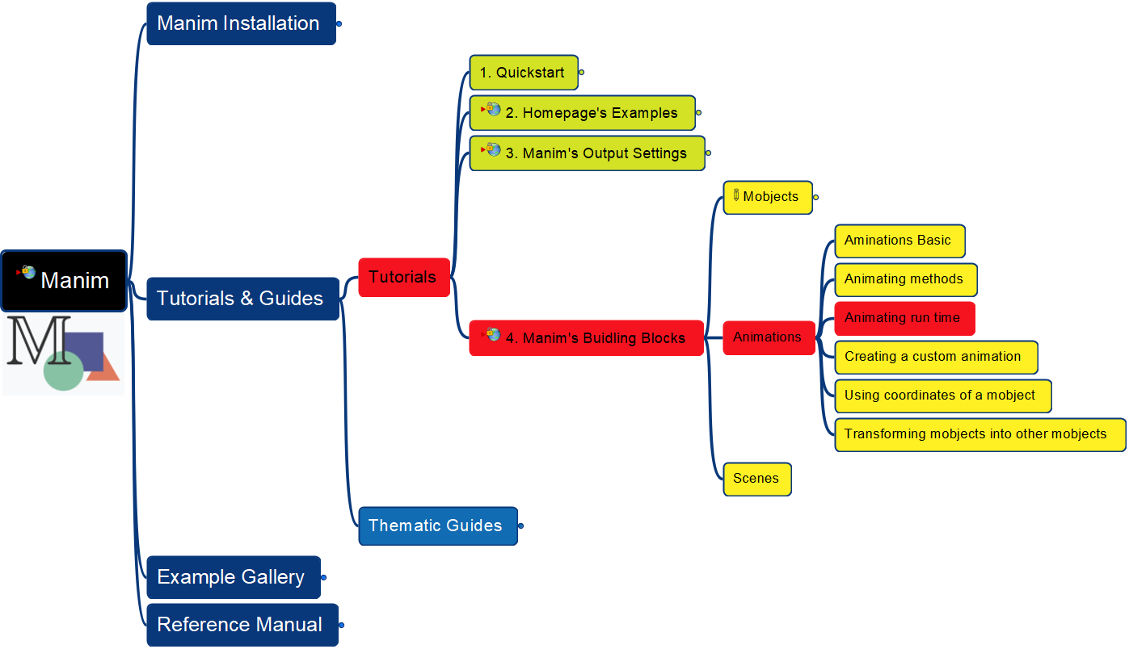
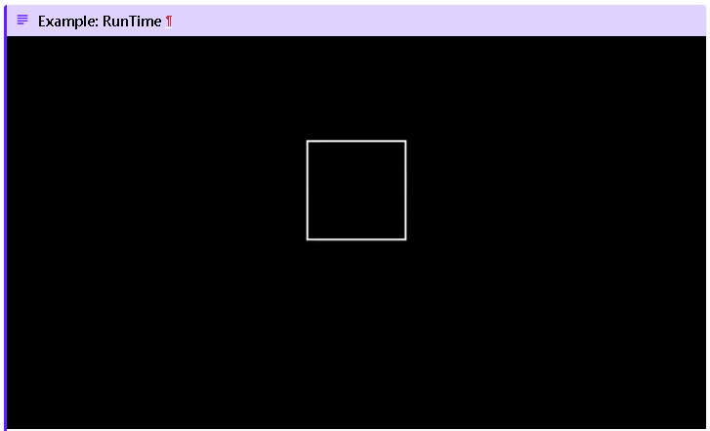
Learning Manim
Building Block – Animations – Run Time
019

Slide 20
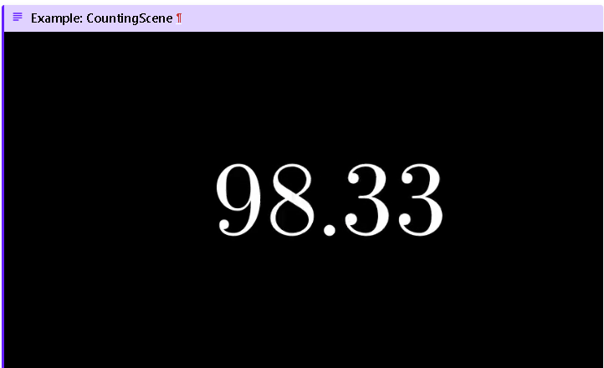
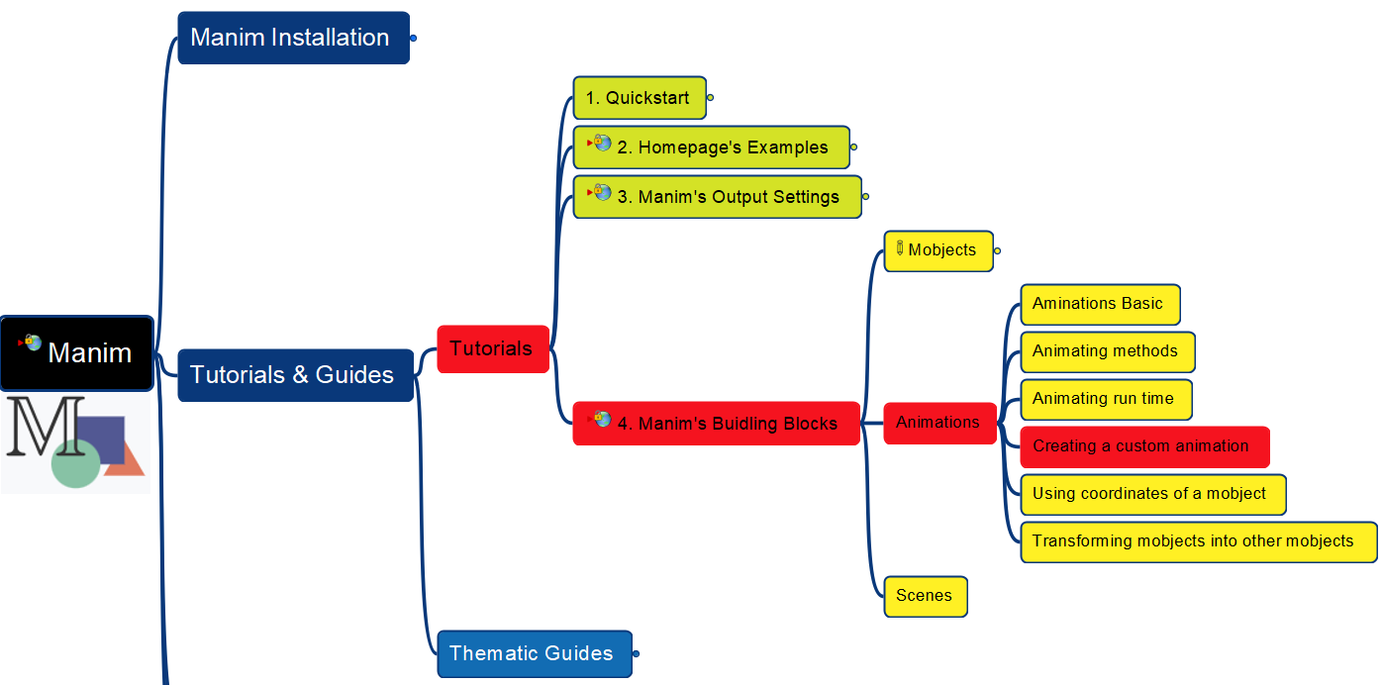
Learning Manim
Building Block – Animations – Customize
020
Missing LaTex

Slide 21
Learning Manim
Building Block – Animations – Customize
021
Continue…

Slide 22
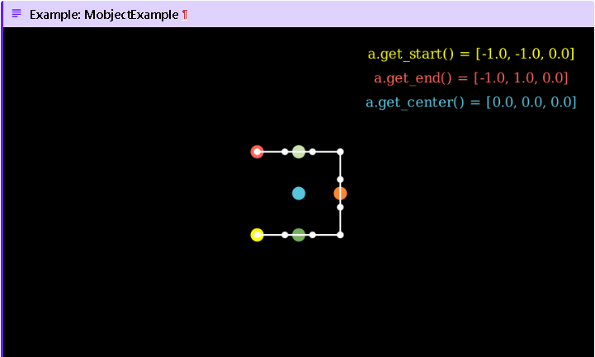
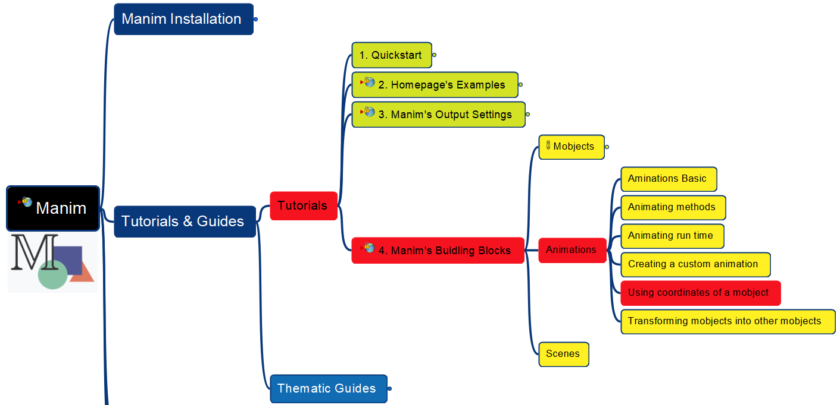
Learning Manim
Building Block – Animations – Use Coordinates
022

Slide 23
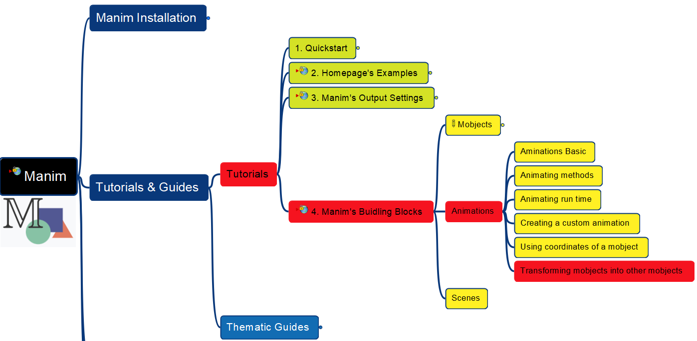
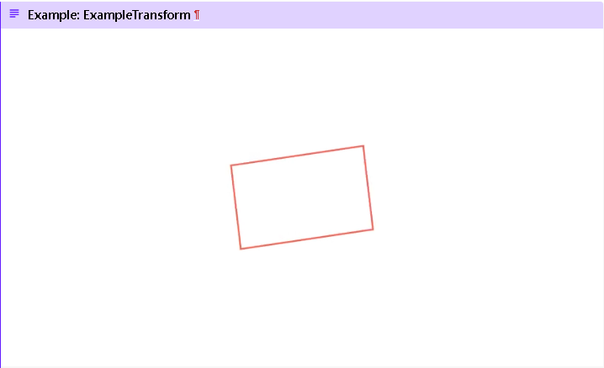
Learning Manim
Building Block – Animations – Transforming
023

Slide 24
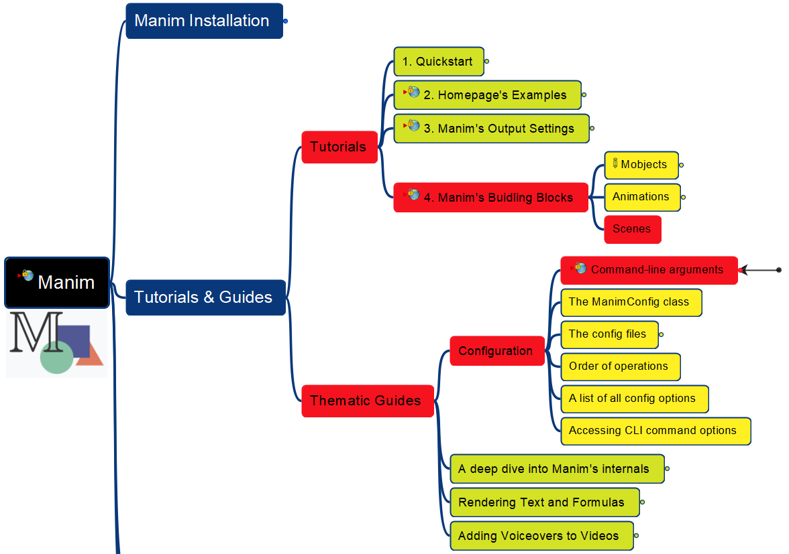
Learning Manim
Building Block – Scenes
Thematic Guides – Configuration – CL Arguments
024

Slide 25
Learning Manim
Thematic Guides – Config – ManimConfig Class
025

Slide 26
